Slide 1
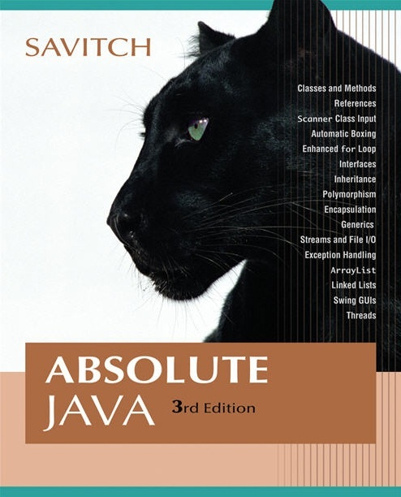


Chapter 7
Inheritance
Copyright © 2008 Pearson Addison-Wesley. All rights reserved

Slide 2
Introduction to Inheritance
Inheritance is one of the main techniques of object-oriented programming (OOP)
Using this technique, a very general form of a class is first defined and compiled, and then more specialized versions of the class are defined by adding instance variables and methods
  The specialized classes are said to inherit the methods and instance variables of the general class
Copyright © 2008 Pearson Addison-Wesley. All rights reserved
7-<number>

Slide 3
Introduction to Inheritance
Inheritance is the process by which a new class is created from another class
  The new class is called a derived class
  The original class is called the base class
A derived class automatically has all the instance variables and methods that the base class has, and it can have additional methods and/or instance variables as well
Inheritance is especially advantageous because it allows code to be reused, without having to copy it into the definitions of the derived classes
Copyright © 2008 Pearson Addison-Wesley. All rights reserved
7-<number>

Slide 4
Derived Classes
When designing certain classes, there is often a natural hierarchy for grouping them
  In a record-keeping program for the employees of a company, there are hourly employees and salaried employees
  Hourly employees can be divided into full time and part time workers
  Salaried employees can be divided into those on technical staff, and those on the executive staff
Copyright © 2008 Pearson Addison-Wesley. All rights reserved
7-<number>

Slide 5
Derived Classes
All employees share certain characteristics in common
  All employees have a name and a hire date
  The methods for setting and changing names and hire dates would be the same for all employees
Some employees have specialized characteristics
  Hourly employees are paid an hourly wage, while salaried employees are paid a fixed wage
  The methods for calculating wages for these two different groups would be different
Copyright © 2008 Pearson Addison-Wesley. All rights reserved
7-<number>

Slide 6
Derived Classes
Within Java, a class called Employee can be defined that includes all employees
This class can then be used to define classes for hourly employees and salaried employees
  In turn, the HourlyEmployee class can be used to define a PartTimeHourlyEmployee class, and so forth
Copyright © 2008 Pearson Addison-Wesley. All rights reserved
7-<number>

Slide 7
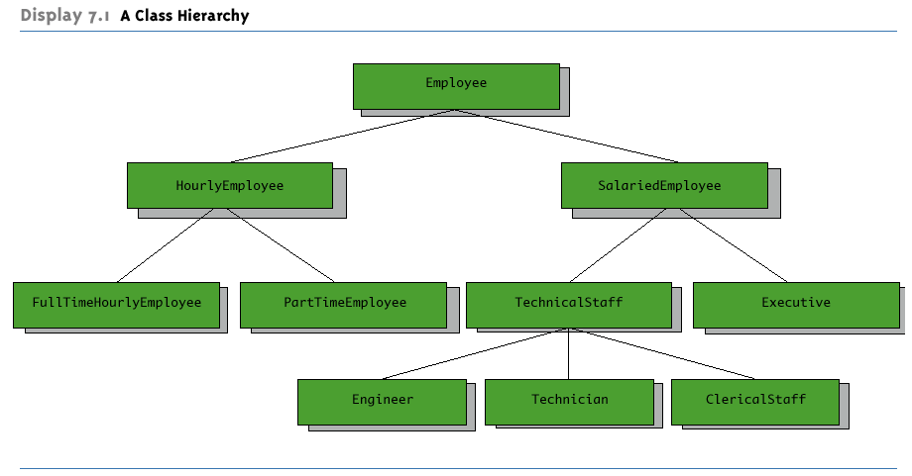
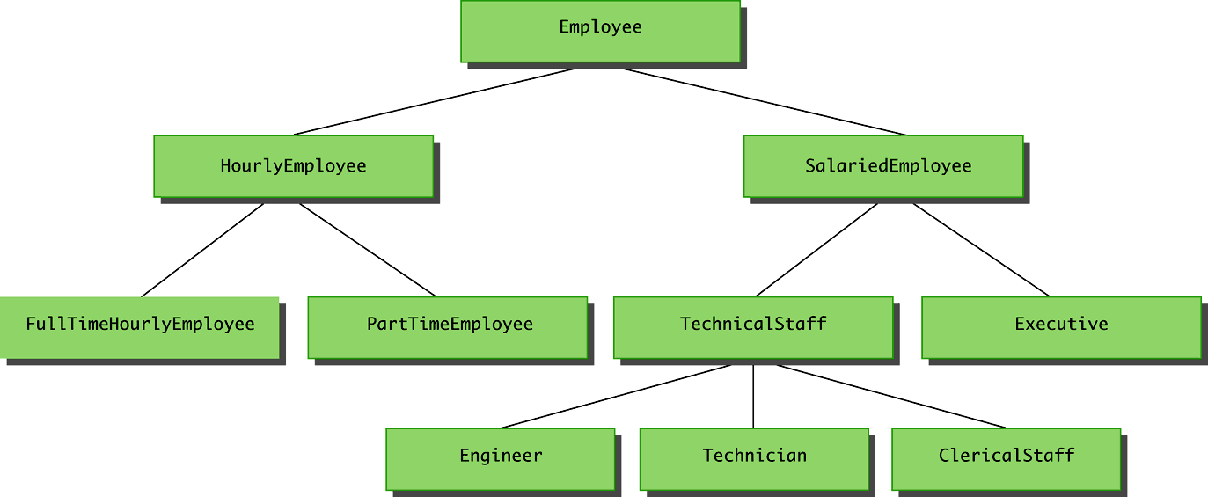
A Class Hierarchy
Copyright © 2008 Pearson Addison-Wesley. All rights reserved
7-<number>

Slide 8
public class Employee
{
private String name;
private Date hireDate;
public Employee( )
{
name = "No name";
hireDate = new Date("Jan", 1, 1000);
}
/**
Precondition: Neither theName nor theDate are null.
*/
public Employee(String theName, Date theDate)
{
if (theName == null || theDate == null)
{
System.out.println("Fatal Error creating employee.");
System.exit(0);
}
name = theName;
hireDate = new Date(theDate);
}
7-<number>

Slide 9
public Employee(Employee originalObject)
{
name = originalObject.name;
hireDate = new Date(originalObject.hireDate);
}
public String getName( )
{
return name;
}
public Date getHireDate( )
{
return new Date(hireDate);
}
public String toString( )
{
return (name + " " + hireDate.toString( ));
}
public boolean equals(Employee otherEmployee)
{
return (name.equals(otherEmployee.name)
&& hireDate.equals(otherEmployee.hireDate));
}
7-<number>

Slide 10
/**
Precondition newName is not null.
*/
public void setName(String newName)
{
if (newName == null)
{
System.out.println("Fatal Error setting employee name.");
System.exit(0);
}
else
name = newName;
}
/**
Precondition newDate is not null.
*/
public void setHireDate(Date newDate)
{
if (newDate == null)
{
System.out.println("Fatal Error setting employee hire date.");
System.exit(0);
}
else
hireDate = new Date(newDate);
}
} // end class Employee
7-<number>

Slide 11
Derived Classes
Since an hourly employee is an employee, it is defined as a derived class of the class Employee
  A derived class is defined by adding instance variables and methods to an existing class
  The existing class that the derived class is built upon is called the base class
  The phrase extends BaseClass must be added to the derived class definition:
  public class HourlyEmployee extends Employee
Copyright © 2008 Pearson Addison-Wesley. All rights reserved
7-<number>

Slide 12
Derived Classes
When a derived class is defined, it is said to inherit the instance variables and methods of the base class that it extends
  Class Employee defines the instance variables name and hireDate in its class definition
  Class HourlyEmployee also has these instance variables, but they are not specified in its class definition
  Class HourlyEmployee has additional instance variables wageRate and hours that are specified in its class definition
Copyright © 2008 Pearson Addison-Wesley. All rights reserved
7-<number>

Slide 13
Derived Classes
Just as it inherits the instance variables of the class Employee, the class HourlyEmployee inherits all of its methods as well
  The class HourlyEmployee inherits the methods getName, getHireDate, setName, and setHireDate from the class Employee
  Any object of the class HourlyEmployee can invoke one of these methods, just like any other method
Copyright © 2008 Pearson Addison-Wesley. All rights reserved
7-<number>

Slide 14
Derived Class (Subclass)
A derived class, also called a subclass, is defined by starting with another already defined class, called a base class or superclass, and adding (and/or changing) methods, instance variables, and static variables
  The derived class inherits all the public methods, all the public and private instance variables, and all the public and private static variables from the base class
  The derived class can add more instance variables, static variables, and/or methods
Copyright © 2008 Pearson Addison-Wesley. All rights reserved
7-<number>

Slide 15
/**
Class Invariant: All objects have a name string, hire date, nonnegative
wage rate, and nonnegative number of hours worked. A name string of
"No name" indicates no real name specified yet. A hire date of Jan 1, 1000
indicates no real hire date specified yet.
*/
public class HourlyEmployee extends Employee
{
private double wageRate;
private double hours; //for the month
public HourlyEmployee( )
{
super( );
wageRate = 0;
hours = 0;
}
7-<number>

Slide 16
/**
Precondition: Neither theName nor theDate are null;
theWageRate and theHours are nonnegative.
*/
public HourlyEmployee(String theName, Date theDate,
double theWageRate, double theHours)
{
super(theName, theDate);
if ((theWageRate >= 0) && (theHours >= 0))
{
wageRate = theWageRate;
hours = theHours;
}
else
{
System.out.println(
"Fatal Error: creating an illegal “ +
“hourly employee.");
System.exit(0);
}
}
7-<number>

Slide 17
public HourlyEmployee(HourlyEmployee originalObject)
{
super(originalObject);
wageRate = originalObject.wageRate;
hours = originalObject.hours;
}
public double getRate( )
{
return wageRate;
}
public double getHours( )
{
return hours;
}
/**
Returns the pay for the month.
*/
public double getPay( )
{
return wageRate*hours;
}
Because of the ISA relationship, an HourlyEmployee is also an instance of the class Employee.
HourlyEmployee ISA Employee
7-<number>

Slide 18
/**
Precondition: hoursWorked is nonnegative.
*/
public void setHours(double hoursWorked)
{
if (hoursWorked >= 0)
hours = hoursWorked;
else
{
System.out.println("Fatal Error: Negative hours worked.");
System.exit(0);
}
}
/**
Precondition: newWageRate is nonnegative.
*/
public void setRate(double newWageRate)
{
if (newWageRate >= 0)
wageRate = newWageRate;
else
{
System.out.println("Fatal Error: Negative wage rate.");
System.exit(0);
}
}
7-<number>

Slide 19
toString( ) is overridden
equals( … ) is overloaded
public String toString( )
{
return (getName( ) + " " + getHireDate( ).toString( )
+ "\n$" + wageRate + " per hour for "
+ hours + " hours");
}
public boolean equals(HourlyEmployee other)
{
return (getName( ).equals(other.getName( ))
&& getHireDate( ).equals(other.getHireDate( ))
&& wageRate == other.wageRate
&& hours == other.hours);
}
}// end class HourlyEmployee
7-<number>

Slide 20
public class InheritanceDemo
{
public static void main(String[] args)
{
HourlyEmployee joe = new HourlyEmployee(
"Joe Worker", new Date("Jan", 1, 2004),
50.50, 160);
System.out.println("joe's longer name is "
+ joe.getName());
System.out.println(
"Changing joe's name to Josephine.");
joe.setName("Josephine");
System.out.println("joe's record is as follows:");
System.out.println(joe);
}
}
7-<number>

Slide 21
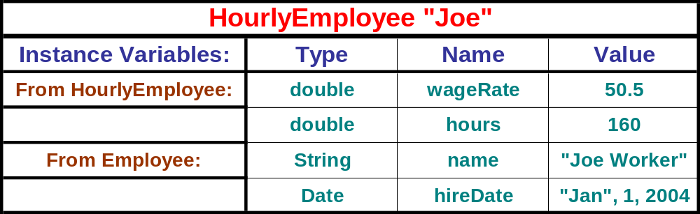
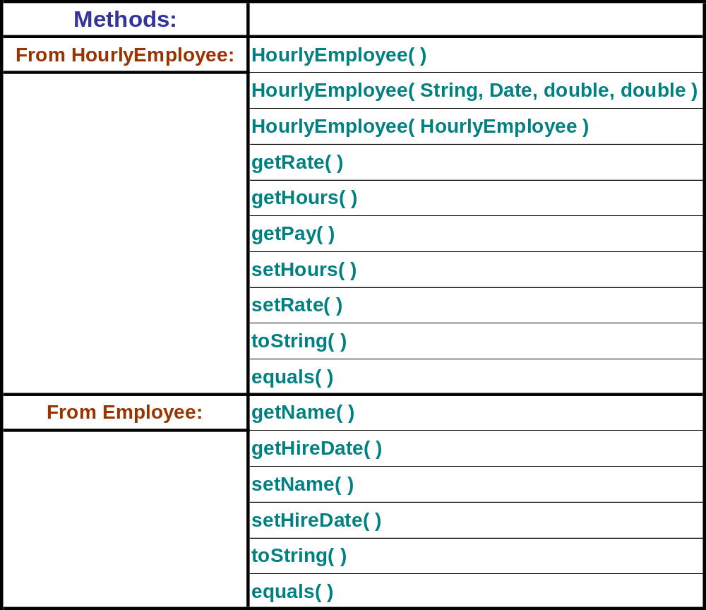
7-<number>

Slide 22
joe's longer name is Joe Worker
Changing joe's name to Josephine.
joe's record is as follows:
Josephine Jan 1, 2004
$50.5 per hour for 160.0 hours
7-<number>

Slide 23
/**
Class Invariant: All objects have a name string, hire date, and
nonnegative salary. A name string of "No name" indicates no real
name specified yet. A hire date of Jan 1, 1000 indicates no real
hire date specified yet.
*/
public class SalariedEmployee extends Employee
{
private double salary; //annual
public SalariedEmployee( )
{
super( );
salary = 0;
}
7-<number>

Slide 24
/**
Precondition: Neither theName nor theDate are null;
theSalary is nonnegative.
*/
public SalariedEmployee(String theName, Date theDate, double theSalary)
{
super(theName, theDate);
if (theSalary >= 0)
salary = theSalary;
else
{
System.out.println("Fatal Error: Negative salary.");
System.exit(0);
}
}
public SalariedEmployee(SalariedEmployee originalObject )
{
super(originalObject);
salary = originalObject.salary;
}
7-<number>

Slide 25
public double getSalary( )
{
return salary;
}
/**
Returns the pay for the month.
*/
public double getPay( )
{
return salary/12;
}
/**
Precondition: newSalary is nonnegative.
*/
public void setSalary(double newSalary)
{
if (newSalary >= 0)
salary = newSalary;
else
{
System.out.println("Fatal Error: Negative salary.");
System.exit(0);
}
}
7-<number>

Slide 26
toString( ) is overridden
equals( … ) is overloaded
public String toString( )
{
return (getName( ) + " " + getHireDate( ).toString( )
+ "\n$" + salary + " per year");
}
public boolean equals(SalariedEmployee other)
{
return (getName( ).equals(other.getName( ))
&& getHireDate( ).equals(other.getHireDate( ))
&& salary == other.salary);
}
} // end class SalariedEmployee
7-<number>

Slide 27
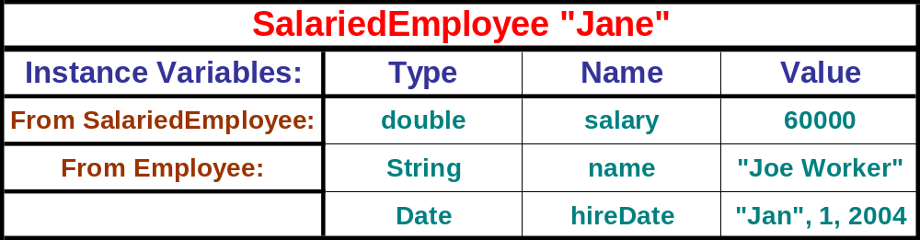
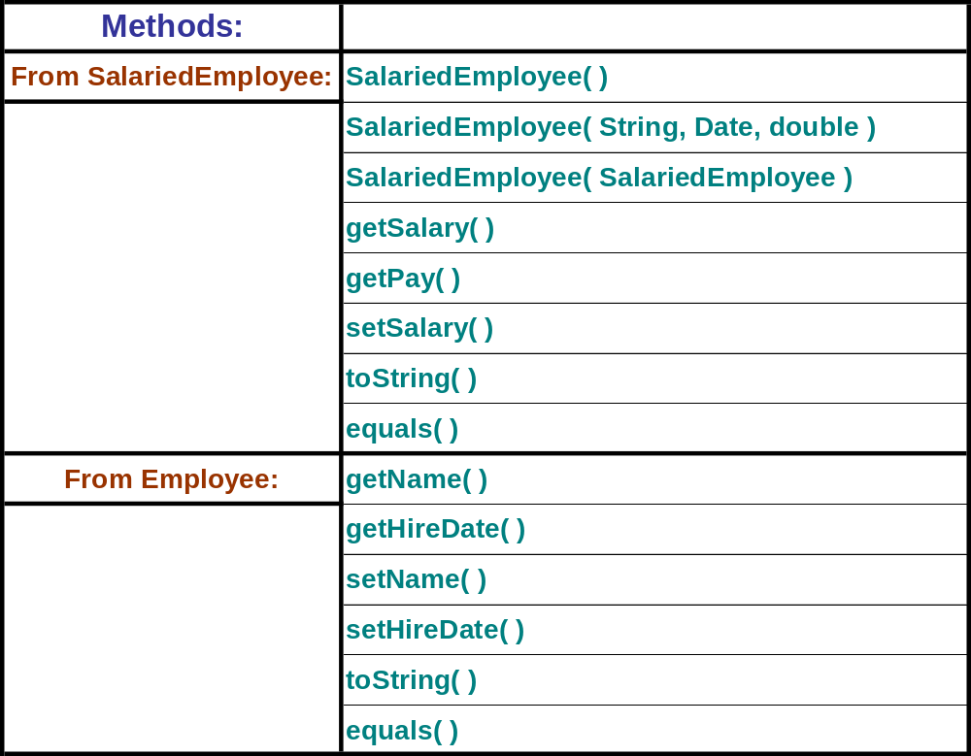
7-<number>

Slide 28
Derived Class (Subclass) (1)
A derived class, also called a subclass, is defined by starting with another already defined class, called a base class or superclass, and adding (and/or changing) methods, instance variables, and static variables
7-<number>

Slide 29
Derived Class (Subclass) (2)
  The derived class inherits all the public methods, all the public and private instance variables, and all the public and private static variables from the base class
  The derived class DOES NOT inherit the constructors or (effectively) private methods from the base class
  The derived class can add more instance variables, static variables, and/or methods
7-<number>

Slide 30
Inherited Members
A derived class automatically has all the instance variables, all the static variables, and all the public methods of the base class
  Members from the base class are said to be inherited
Definitions for the inherited variables and methods do not appear in the derived class
  The code is reused without having to explicitly copy it, unless the creator of the derived class redefines one or more of the base class methods
Copyright © 2008 Pearson Addison-Wesley. All rights reserved
7-<number>

Slide 31
Parent and Child Classes
A base class is often called the parent class
  A derived class is then called a child class
These relationships are often extended such that a class that is a parent of a parent . . . of another class is called an ancestor class
  If class A is an ancestor of class B, then class B can be called a descendent of class A
Copyright © 2008 Pearson Addison-Wesley. All rights reserved
7-<number>

Slide 32
Overriding a Method Definition
Although a derived class inherits methods from the base class, it can change or override an inherited method if necessary
  In order to override a method definition, a new definition of the method is simply placed in the class definition, just like any other method that is added to the derived class
Copyright © 2008 Pearson Addison-Wesley. All rights reserved
7-<number>
Notes:
-

Slide 33
Changing the Return Type of an Overridden Method
Ordinarily, the type returned may not be changed when overriding a method
However, if it is a class type, then the returned type may be changed to that of any descendent class of the returned type
This is known as a covariant return type
  Covariant return types are new in Java 5.0; they are not allowed in earlier versions of Java
Copyright © 2008 Pearson Addison-Wesley. All rights reserved
7-<number>

Slide 34
Covariant Return Type
Given the following base class:
  public class BaseClass
  { . . .
  public Employee getSomeone(int someKey)
  . . .
The following is allowed in Java 5.0:
  public class DerivedClass extends BaseClass
  { . . .
  public HourlyEmployee getSomeone(int someKey)
  . . .
Copyright © 2008 Pearson Addison-Wesley. All rights reserved
7-<number>

Slide 35
Changing the Access Permission of an Overridden Method
The access permission of an overridden method can be changed from private in the base class to public (or some other more permissive access) in the derived class
However, the access permission of an overridden method can not be changed from public in the base class to a more restricted access permission in the derived class
Copyright © 2008 Pearson Addison-Wesley. All rights reserved
7-<number>

Slide 36
Changing the Access Permission of an Overridden Method
Given the following method header in a base case:
  private void doSomething()
The following method header is valid in a derived class:
  public void doSomething()
However, the opposite is not valid
Given the following method header in a base case:
  public void doSomething()
The following method header is not valid in a derived class:
  private void doSomething()
Copyright © 2008 Pearson Addison-Wesley. All rights reserved
7-<number>

Slide 37
Pitfall: Overriding Versus Overloading
Do not confuse overriding a method in a derived class with overloading a method name
  When a method is overridden, the new method definition given in the derived class has the exact same number and types of parameters as in the base class
  When a method in a derived class has a different signature from the method in the base class, that is overloading
  Note that when the derived class overloads the original method, it still inherits the original method from the base class as well
Copyright © 2008 Pearson Addison-Wesley. All rights reserved
7-<number>

Slide 38
The final Modifier
If the modifier final is placed before the definition of a method, then that method may not be redefined in a derived class
If the modifier final is placed before the definition of a class, then that class may not be used as a base class to derive other classes
Copyright © 2008 Pearson Addison-Wesley. All rights reserved
7-<number>

Slide 39
The super Constructor
A derived class uses a constructor from the base class to initialize all the data inherited from the base class
  In order to invoke a constructor from the base class, it uses a special syntax:
public derivedClass(int p1, int p2, double p3)
{
super(p1, p2);
instanceVariable = p3;
}
  In the above example, super(p1, p2); is a call to the base class constructor
Copyright © 2008 Pearson Addison-Wesley. All rights reserved
7-<number>

Slide 40
The super Constructor
A call to the base class constructor can never use the name of the base class, but uses the keyword super instead
A call to super must always be the first action taken in a constructor definition
An instance variable cannot be used as an argument to super
Copyright © 2008 Pearson Addison-Wesley. All rights reserved
7-<number>

Slide 41
The super Constructor
If a derived class constructor does not include an invocation of super, then the no-argument constructor of the base class will automatically be invoked
  This can result in an error if the base class has not defined a no-argument constructor
Since the inherited instance variables should be initialized, and the base class constructor is designed to do that, then an explicit call to super should always be used
Copyright © 2008 Pearson Addison-Wesley. All rights reserved
7-<number>

Slide 42
The this Constructor
Within the definition of a constructor for a class, this can be used as a name for invoking another constructor in the same class
  The same restrictions on how to use a call to super apply to the this constructor
If it is necessary to include a call to both super and this, the call using this must be made first, and then the constructor that is called must call super as its first action
Copyright © 2008 Pearson Addison-Wesley. All rights reserved
7-<number>

Slide 43
The this Constructor
Often, a no-argument constructor uses this to invoke an explicit-value constructor
  No-argument constructor (invokes explicit-value constructor using this and default arguments):
    public ClassName()
    {
    this(argument1, argument2);
    }
  Explicit-value constructor (receives default values):
    public ClassName(type1 param1, type2 param2)
    {
    . . .
    }
Copyright © 2008 Pearson Addison-Wesley. All rights reserved
7-<number>

Slide 44
The this Constructor
  public HourlyEmployee()
  {
  this("No name", new Date(), 0, 0);
  }
The above constructor will cause the constructor with the following heading to be invoked:
  public HourlyEmployee(String theName, Date theDate, double theWageRate, double theHours)
Copyright © 2008 Pearson Addison-Wesley. All rights reserved
7-<number>

Slide 45
Tip: An Object of a Derived Class Has More than One Type
An object of a derived class has the type of the derived class, and it also has the type of the base class
More generally, an object of a derived class has the type of every one of its ancestor classes
  Therefore, an object of a derived class can be assigned to a variable of any ancestor type
Copyright © 2008 Pearson Addison-Wesley. All rights reserved
7-<number>

Slide 46
Tip: An Object of a Derived Class Has More than One Type
An object of a derived class can be plugged in as a parameter in place of any of its ancestor classes
In fact, a derived class object can be used anyplace that an object of any of its ancestor types can be used
Note, however, that this relationship does not go the other way
  An ancestor type can never be used in place of one of its derived types
Copyright © 2008 Pearson Addison-Wesley. All rights reserved
7-<number>

Slide 47
HourlyEmployee joe = new HourlyEmployee("Joe Worker",
new Date("January", 1, 2004), 50.50, 160);
SalariedEmployee Sue = new SalariedEmployee("Sue Lee",
new Date("March", 1, 2005), 30000);
Date hireDate = new Date("April", 10, 2008);
Employee Tom = new Employee("Tom Kim", hireDate);
System.out.println("from HourlyEmployee joe: " + joe.getName( ));
System.out.println("from SalariedEmployee Sue: " + Sue.getName( ));
System.out.println("from Employee Tom: " + Tom.getName( ));
7-<number>

Slide 48
System.out.println("from HourlyEmployee joe: " + joe + "\n");
System.out.println("from SalariedEmployee Sue: " + Sue +"\n" );
System.out.println("from Employee Tom: " + Tom + "\n");
Copyright © 2008 Pearson Addison-Wesley. All rights reserved
7-<number>

Slide 49
System.out.println("from Employee Tom: " + Tom + "\n");
System.out.println("from HourlyEmployee joe: " + joe +"\n" );
Tom = joe;
System.out.println("from Employee Tom: " + Tom + "\n"); */
Copyright © 2008 Pearson Addison-Wesley. All rights reserved
7-<number>

Slide 50
System.out.println("from Employee Tom: " + Tom + "\n");
System.out.println("from SalariedEmployee Sue: " + Sue +"\n" );
Tom = Sue;
System.out.println("from Employee Tom: " + Tom + "\n");
=================================================
Sue = Tom;
================================================
joe = Tom;
Copyright © 2008 Pearson Addison-Wesley. All rights reserved
7-<number>

Slide 51
Pitfall: The Terms "Subclass" and "Superclass"
The terms subclass and superclass are sometimes mistakenly reversed
  A superclass or base class is more general and inclusive, but less complex
  A subclass or derived class is more specialized, less inclusive, and more complex
    As more instance variables and methods are added, the number of objects that can satisfy the class definition becomes more restricted
Copyright © 2008 Pearson Addison-Wesley. All rights reserved
7-<number>

Slide 52
An Enhanced StringTokenizer Class
Thanks to inheritance, most of the standard Java library classes can be enhanced by defining a derived class with additional methods
For example, the StringTokenizer class enables all the tokens in a string to be generated one time
  However, sometimes it would be nice to be able to cycle through the tokens a second or third time
Copyright © 2008 Pearson Addison-Wesley. All rights reserved
7-<number>

Slide 53
The StringTokenizer Class
The StringTokenizer class is used to recover the words or tokens in a multi-word String
  You can use whitespace characters to separate each token, or you can specify the characters you wish to use as separators
  In order to use the StringTokenizer class, be sure to include the following at the start of the file:
  import java.util.StringTokenizer;
  See StringTokenizerDemo
7-<number>

Slide 54
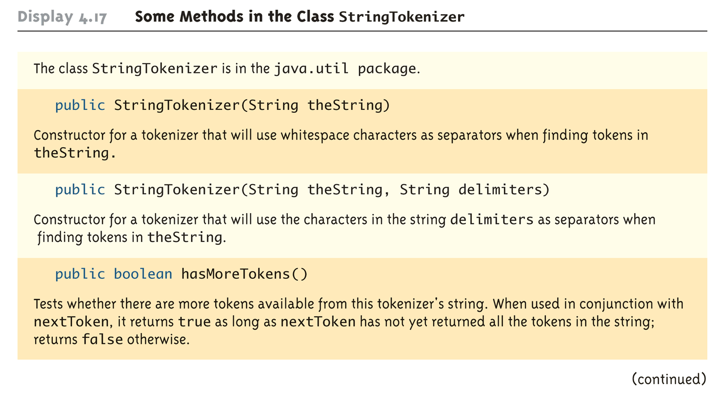
Some Methods in the StringTokenizer Class (Part 1 of 2)
7-<number>

Slide 55
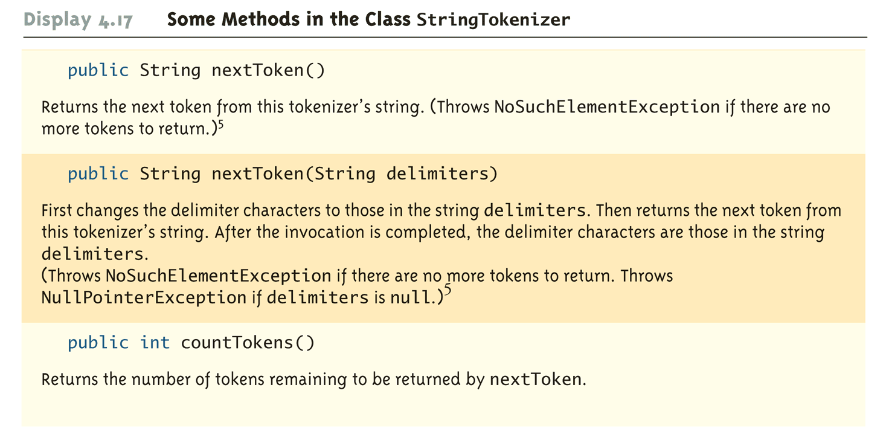
Some Methods in the StringTokenizer Class (Part 2 of 2)
7-<number>

Slide 56
An Enhanced StringTokenizer Class
This can be made possible by creating a derived class:
  For example, EnhancedStringTokenizer can inherit the useful behavior of StringTokenizer
  It inherits the countTokens method unchanged
The new behavior can be modeled by adding new methods, and/or overriding existing methods
  A new method, tokensSoFar, is added
  While an existing method, nextToken, is overriden
Copyright © 2008 Pearson Addison-Wesley. All rights reserved
7-<number>

Slide 57
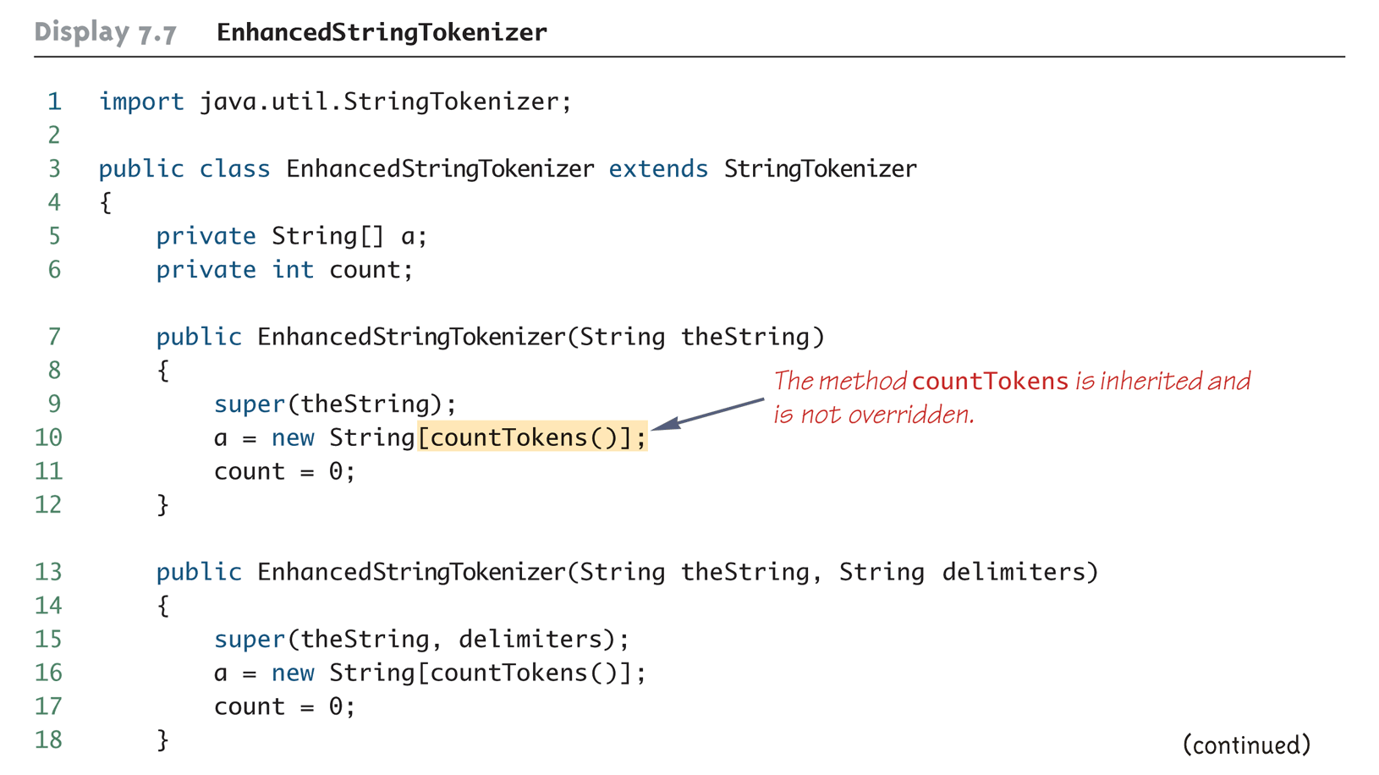
An Enhanced StringTokenizer Class
(Part 1 of 4)
Copyright © 2008 Pearson Addison-Wesley. All rights reserved
7-<number>

Slide 58
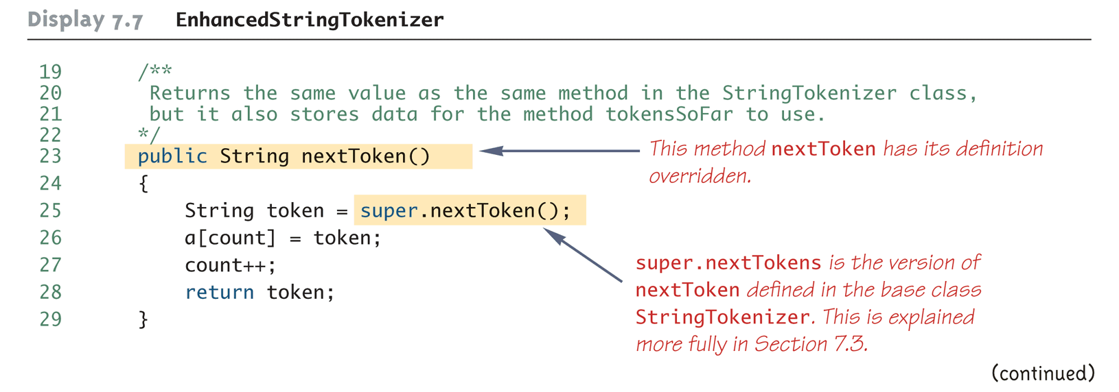
An Enhanced StringTokenizer Class
(Part 2 of 4)
Copyright © 2008 Pearson Addison-Wesley. All rights reserved
7-<number>

Slide 59
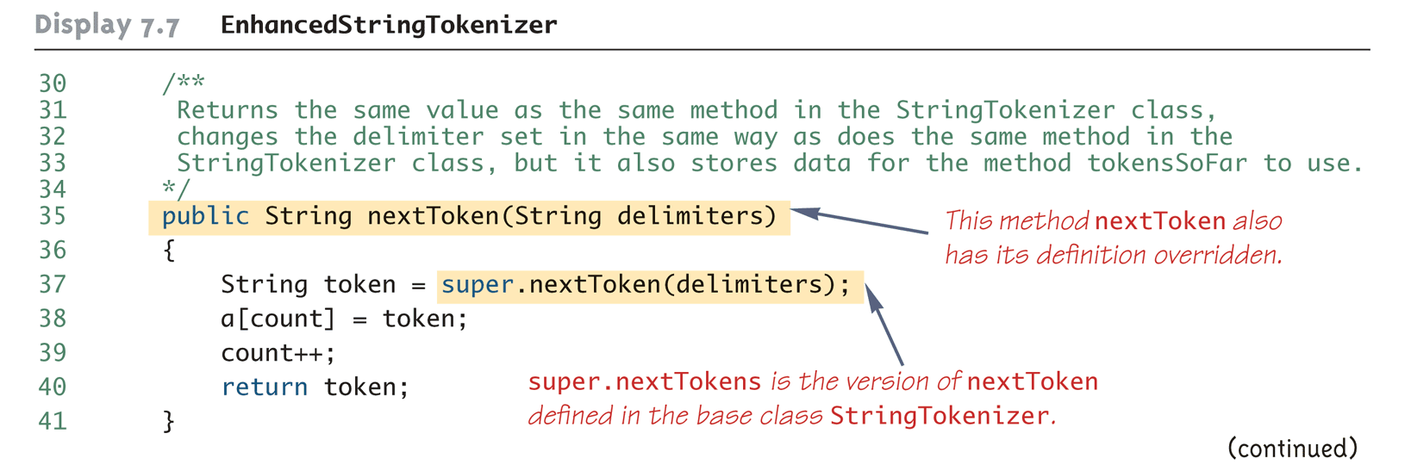
An Enhanced StringTokenizer Class
(Part 3 of 4)
Copyright © 2008 Pearson Addison-Wesley. All rights reserved
7-<number>

Slide 60
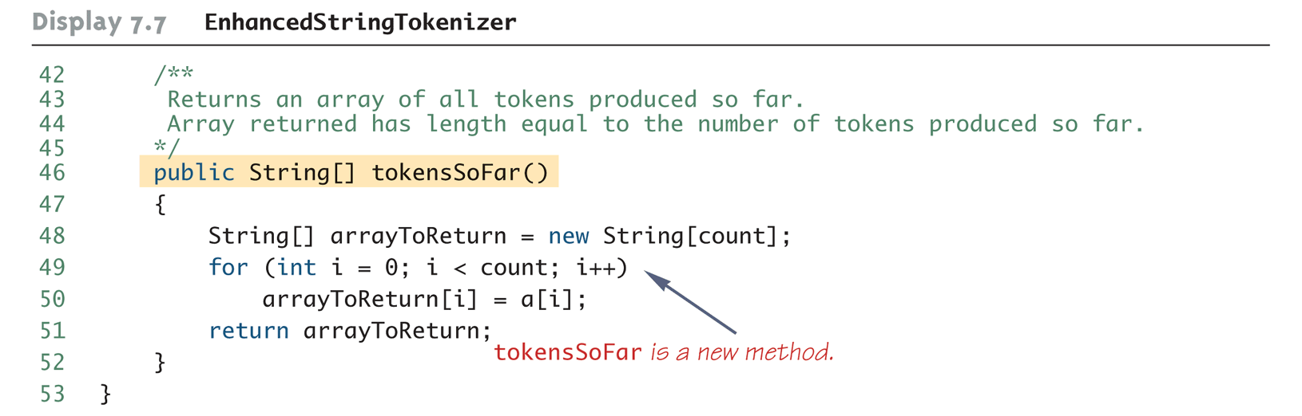
An Enhanced StringTokenizer Class
(Part 4 of 4)
Copyright © 2008 Pearson Addison-Wesley. All rights reserved
7-<number>

Slide 61
Show Enhanced StringTokenizerDemo
Copyright © 2008 Pearson Addison-Wesley. All rights reserved
7-<number>

Slide 62
Encapsulation and Inheritance Pitfall: Use of Private Instance Variables from the Base Class
An instance variable that is private in a base class is not accessible by name in the definition of a method in any other class, not even in a method definition of a derived class
  For example, an object of the HourlyEmployee class cannot access the private instance variable hireDate by name, even though it is inherited from the Employee base class
Instead, a private instance variable of the base class can only be accessed by the public accessor and mutator methods defined in that class
  An object of the HourlyEmployee class can use the getHireDate or setHireDate methods to access hireDate
Copyright © 2008 Pearson Addison-Wesley. All rights reserved
7-<number>

Slide 63
Encapsulation and Inheritance Pitfall: Use of Private Instance Variables from the Base Class
If private instance variables of a class were accessible in method definitions of a derived class, then anytime someone wanted to access a private instance variable, they would only need to create a derived class, and access it in a method of that class
  This would allow private instance variables to be changed by mistake or in inappropriate ways (for example, by not using the base type's accessor and mutator methods only)
Copyright © 2008 Pearson Addison-Wesley. All rights reserved
7-<number>

Slide 64
Pitfall: Private Methods Are Effectively Not Inherited
The private methods of the base class are like private variables in terms of not being directly available
However, a private method is completely unavailable, unless invoked indirectly
  This is possible only if an object of a derived class invokes a public method of the base class that happens to invoke the private method
This should not be a problem because private methods should just be used as helping methods
  If a method is not just a helping method, then it should be public, not private
Copyright © 2008 Pearson Addison-Wesley. All rights reserved
7-<number>

Slide 65
Protected and Package Access
If a method or instance variable is modified by protected (rather than public or private), then it can be accessed by name
  Inside its own class definition
  Inside any class derived from it
  In the definition of any class in the same package
The protected modifier provides very weak protection compared to the private modifier
  It allows direct access to any programmer who defines a suitable derived class
  Therefore, instance variables should normally not be marked protected
Copyright © 2008 Pearson Addison-Wesley. All rights reserved
7-<number>

Slide 66
Protected and Package Access
An instance variable or method definition that is not preceded with a modifier has package access
  Package access is also known as default or friendly access
Instance variables or methods having package access can be accessed by name inside the definition of any class in the same package
  However, neither can be accessed outside the package
Copyright © 2008 Pearson Addison-Wesley. All rights reserved
7-<number>

Slide 67
Protected and Package Access
Note that package access is more restricted than protected
  Package access gives more control to the programmer defining the classes
  Whoever controls the package directory (or folder) controls the package access
Copyright © 2008 Pearson Addison-Wesley. All rights reserved
7-<number>

Slide 68
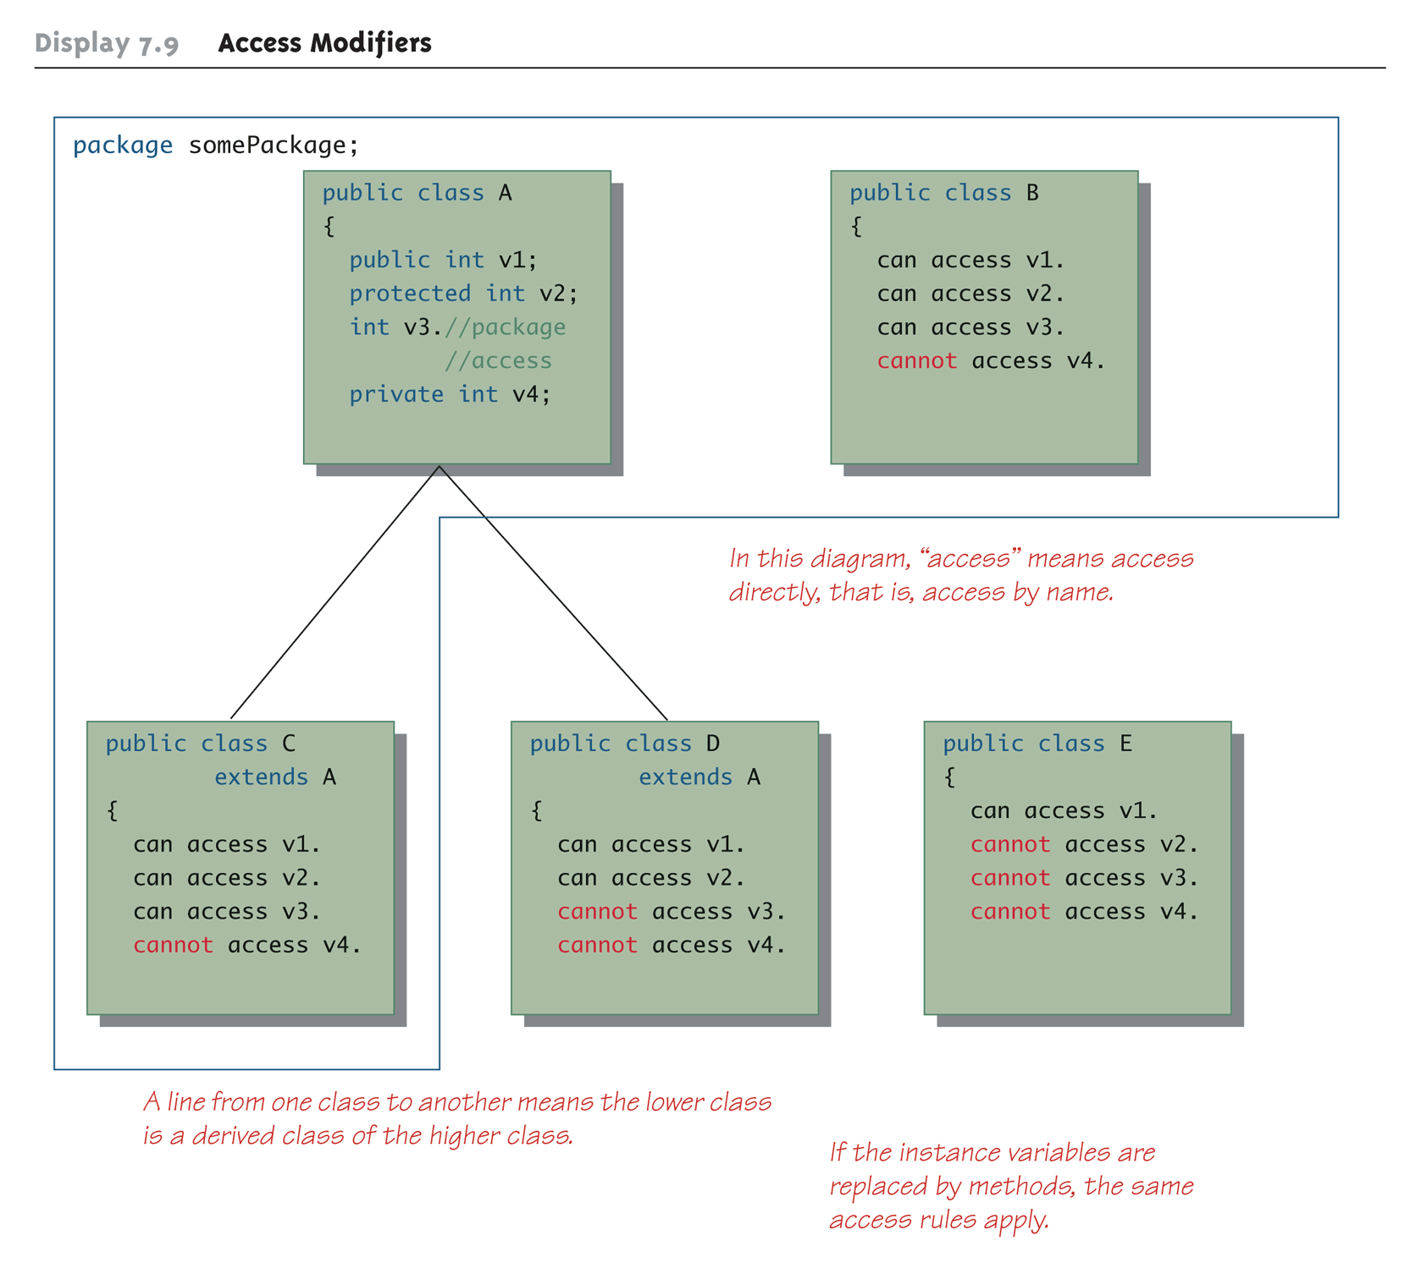
Access Modifiers
Copyright © 2008 Pearson Addison-Wesley. All rights reserved
7-<number>

Slide 69
Pitfall: Forgetting About the Default Package
When considering package access, do not forget the default package
  All classes in the current directory (not belonging to some other package) belong to an unnamed package called the default package
If a class in the current directory is not in any other package, then it is in the default package
  If an instance variable or method has package access, it can be accessed by name in the definition of any other class in the default package
Copyright © 2008 Pearson Addison-Wesley. All rights reserved
7-<number>

Slide 70
Tip: "Is a" Versus "Has a"
A derived class demonstrates an "is a" relationship between it and its base class
  Forming an "is a" relationship is one way to make a more complex class out of a simpler class
  For example, an HourlyEmployee "is an" Employee
  HourlyEmployee is a more complex class compared to the more general Employee class
Copyright © 2008 Pearson Addison-Wesley. All rights reserved
7-<number>

Slide 71
Tip: "Is a" Versus "Has a"
Another way to make a more complex class out of a simpler class is through a "has a" relationship
  This type of relationship, called composition, occurs when a class contains an instance variable of a class type
  The Employee class contains an instance variable, hireDate, of the class Date, so therefore, an Employee "has a" Date
Copyright © 2008 Pearson Addison-Wesley. All rights reserved
7-<number>

Slide 72
Tip: "Is a" Versus "Has a"
Both kinds of relationships are commonly used to create complex classes, often within the same class
  Since HourlyEmployee is a derived class of Employee, and contains an instance variable of class Date, then HourlyEmployee "is an" Employee and "has a" Date
  Show IsADemo
Copyright © 2008 Pearson Addison-Wesley. All rights reserved
7-<number>

Slide 73
Tip: Static Variables Are Inherited
Static variables in a base class are inherited by any of its derived classes
The modifiers public, private, and protected, and package access have the same meaning for static variables as they do for instance variables
Copyright © 2008 Pearson Addison-Wesley. All rights reserved
7-<number>

Slide 74
Access to a Redefined Base Method
Within the definition of a method of a derived class, the base class version of an overridden method of the base class can still be invoked
  Simply preface the method name with super and a dot
  public String toString()
  {
  return (super.toString() + "$" + wageRate);
  }
However, using an object of the derived class outside of its class definition, there is no way to invoke the base class version of an overridden method (****)
Copyright © 2008 Pearson Addison-Wesley. All rights reserved
7-<number>

Slide 75
You Cannot Use Multiple supers
It is only valid to use super to invoke a method from a direct parent
  Repeating super will not invoke a method from some other ancestor class
For example, if the Employee class were derived from the class Person, and the HourlyEmployee class were derived form the class Employee , it would not be possible to invoke the toString method of the Person class within a method of the HourlyEmployee class
  super.super.toString() // ILLEGAL!
Copyright © 2008 Pearson Addison-Wesley. All rights reserved
7-<number>

Slide 76
The Class Object
In Java, every class is a descendent of the class Object
  Every class has Object as its ancestor
  Every object of every class is of type Object, as well as being of the type of its own class
If a class is defined that is not explicitly a derived class of another class, it is still automatically a derived class of the class Object
Copyright © 2008 Pearson Addison-Wesley. All rights reserved
7-<number>

Slide 77
The Class Object
The class Object is in the package java.lang which is always imported automatically
Having an Object class enables methods to be written with a parameter of type Object
  A parameter of type Object can be replaced by an object of any class whatsoever
  For example, some library methods accept an argument of type Object so they can be used with an argument that is an object of any class
Copyright © 2008 Pearson Addison-Wesley. All rights reserved
7-<number>

Slide 78
The Class Object
The class Object has some methods that every Java class inherits
  For example, the equals and toString methods
Every object inherits these methods from some ancestor class
  Either the class Object itself, or a class that itself inherited these methods (ultimately) from the class Object
However, these inherited methods should be overridden with definitions more appropriate to a given class
  Some Java library classes assume that every class has its own version of such methods
Copyright © 2008 Pearson Addison-Wesley. All rights reserved
7-<number>

Slide 79
The Right Way to Define equals
Since the equals method is always inherited from the class Object, methods like the following simply overload it:
  public boolean equals(Employee otherEmployee)
  { . . . }
However, this method should be overridden, not just overloaded:
  public boolean equals(Object otherObject)
  { . . . }
Copyright © 2008 Pearson Addison-Wesley. All rights reserved
7-<number>

Slide 80
The original equals Method for the Class Employee
public boolean equals(Employee otherEmployee)
{
return (name.equals(otherEmployee.name)
&& hireDate.equals(otherEmployee.hireDate));
}
====================================
The right way to define equals:
  public boolean equals(Object otherObject)
  { . . . }
7-<number>

Slide 81
The Right Way to Define equals
The overridden version of equals must meet the following conditions
  The parameter otherObject of type Object must be type cast to the given class (e.g., Employee)
  However, the new method should only do this if otherObject really is an object of that class, and if otherObject is not equal to null
  Finally, it should compare each of the instance variables of both objects
Copyright © 2008 Pearson Addison-Wesley. All rights reserved
7-<number>

Slide 82
A Better equals Method for the Class Employee
public boolean equals(Object otherObject)
{
if(otherObject == null)
return false;
else if(getClass( ) != otherObject.getClass( ))
return false;
else
{
Employee otherEmployee = (Employee)otherObject;
return (name.equals(otherEmployee.name) &&
hireDate.equals(otherEmployee.hireDate));
}
}
  Note:
  // else if(!(OtherObject instanceof Employee))
  return false; . . .
Copyright © 2008 Pearson Addison-Wesley. All rights reserved
7-<number>

Slide 83
Tip: getClass Versus instanceof
Many authors suggest using the instanceof operator in the definition of equals
  Instead of the getClass() method
The instanceof operator will return true if the object being tested is a member of the class for which it is being tested
  However, it will return true if it is a descendent of that class as well
It is possible (and especially disturbing), for the equals method to behave inconsistently given this scenario
Copyright © 2008 Pearson Addison-Wesley. All rights reserved
7-<number>

Slide 84
Tip: getClass Versus instanceof
Here is an example using the class Employee
if(otherObject == null)
return false;
else if(getClass( ) != otherObject.getClass( ))
return false;
  . . . //excerpt from bad equals method
  else if(!(OtherObject instanceof Employee))
  return false; . . .
7-<number>

Slide 85
Tip: getClass Versus instanceof
Here is an example using the class Employee
  . . . //excerpt from bad equals method
  else if(!(OtherObject instanceof Employee))
  return false; . . .
Now consider the following:
  Employee e = new Employee("Joe", new Date());
  HourlyEmployee h = new
  HourlyEmployee("Joe", new Date(),8.5, 40);
  boolean testH = e.equals(h);// return T
  boolean testE = h.equals(e);// return F
Copyright © 2008 Pearson Addison-Wesley. All rights reserved
7-<number>

Slide 86
Example of using instanceof
(in Employee class)
public boolean equals(Object otherObject)
{
if(otherObject == null)
return false;
  else if(!(OtherObject instanceof Employee))
  return false;
  else
{
Employee otherEmployee = (Employee)otherObject;
return (name.equals(otherEmployee.name) &&
hireDate.equals(otherEmployee.hireDate));
}
}
===========================================================
  boolean testH = e.equals(h); //return true
  else if(!(h instanceof Employee))
  return false; // this will not be executed
7-<number>

Slide 87
Example of using instanceof
(in HourlyEmployee class)
public boolean equals(Object otherObject)
{
if(otherObject == null)
return false;
  else if(!(OtherObject instanceof HourlyEmployee))
  return false;
  else
{
HourlyEmployee otherHourlyEmployee =
(HourlyEmployee)otherObject;
return (super.equals(otherHourlyEmployee)
&& (wageRate == otherHourlyEmployee.wageRate)
&& (hours == otherHourlyEmployee.hours));
}
}
===========================================================
  boolean testE = h.equals(e);// //return false
  else if(!(e instanceof HourlyEmployee))
  return false;//stop here
7-<number>

Slide 88
Tip: getClass Versus instanceof
testH will be true, because h is an Employee with the same name and hire date as e
However, testE will be false, because e is not an HourlyEmployee, and cannot be compared to h
Note that this problem would not occur if the getClass() method were used instead, as in the previous equals method example
Copyright © 2008 Pearson Addison-Wesley. All rights reserved
7-<number>

Slide 89
instanceof and getClass
Both the instanceof operator and the getClass() method can be used to check the class of an object
However, the getClass() method is more exact
  The instanceof operator simply tests the class of an object
  The getClass() method used in a test with == or != tests if two objects were created with the same class
Copyright © 2008 Pearson Addison-Wesley. All rights reserved
7-<number>

Slide 90
Creating objects
  Employee e = new Employee("Joe", new Date());
  HourlyEmployee h = new
  HourlyEmployee("Joe", new Date(),8.5, 40);
7-<number>

Slide 91
The instanceof Operator
The instanceof operator checks if an object is of the type given as its second argument
  Object instanceof ClassName
  This will return true if Object is of type ClassName, and otherwise return false
  Note that this means it will return true if Object is the type of any descendent class of ClassName
  e instanceof Employee //return T
  h instanceof Employee // T
  e instanceof HourlyEmployee //F
  h instanceof HourlyEmployee //T
7-<number>

Slide 92
The getClass() Method
Every object inherits the same getClass() method from the Object class
  This method is marked final, so it cannot be overridden
An invocation of getClass() on an object returns a representation only of the class that was used with new to create the object
  The results of any two such invocations can be compared with == or != to determine whether or not they represent the exact same class
    (object1.getClass() == object2.getClass())
Copyright © 2008 Pearson Addison-Wesley. All rights reserved
7-<number>

Slide 93
Example of getClass()
(object1.getClass() == object2.getClass())
e.getClass() will return Employee
h.getClass() will return HourlyEmployee
e.getClass() == h.getClass()) //will return false
//both will
  boolean testH = e.equals(h);//return
  boolean testE = h.equals(e);//false
7-<number>

Slide 94
Example of using getClass()
(in Employee class)
public boolean equals(Object otherObject)
{
if(otherObject == null)
return false;
else if(getClass( ) != otherObject.getClass( ))
return false;
  else
{
Employee otherEmployee = (Employee)otherObject;
return (name.equals(otherEmployee.name) &&
hireDate.equals(otherEmployee.hireDate));
}
}
===========================================================
  boolean testH = e.equals(h); //return false
  else if(getClass( ) != h.getClass( ))
  return false; // stop here
7-<number>

Slide 95
Example of using getClass()
(in HourlyEmployee class)
public boolean equals(Object otherObject)
{
if(otherObject == null)
return false;
  else if(getClass( ) != otherObject.getClass( ))
  return false;
  else
{
HourlyEmployee otherHourlyEmployee =
(HourlyEmployee)otherObject;
return (super.equals(otherHourlyEmployee)
&& (wageRate == otherHourlyEmployee.wageRate)
&& (hours == otherHourlyEmployee.hours));
}
}
===========================================================
  boolean testE = h.equals(e);// //return false
  else if(getClass( ) != e.getClass( ))
  return false;//stop here
7-<number>

